Slide 1
CS561 Fall 2018 Foundation of Artificial Intelligence
Unsupervised Learning and the EM Algorithm
Tuesday Lectures, Session 24
6:40-7:55 & 8:05-9:20
Professor Wei-Min Shen

Slide 2

What You Learn in This Class?
Learn AI and ML
Learn how to learn by yourself
EM Algorithm
Machine Learning
Probability Reasoning
Knowledge Representation
General AI

Slide 3
Session 24
Unsupervised Learning
Clustering
Naïve Bayes Models (e.g., Autoclasses)
K-Means Clustering Algorithm
The EM algorithm
Learning POMDP from experience (ALFE 4-5)
EM: the Crown-Jewel of Machine Learning !!!
I am so proud that you are learning this ☺

Slide 4
Unsupervised Learning
Type I: Clustering the data
Automatically group the data into clusters
Type II: Parameter Learning (states known)
Learn transitions, sensor models, & current state
Type III: Structural or Non-parametric Learning
States not known and must be learned
States are not just “symbols” but have structures
These will be for future lectures (if time permits)

Slide 5

Clustering
Clustering systems:
Unsupervised learning
Detect patterns in unlabeled data
E.g. group emails or search results
E.g. find categories of customers
E.g. detect anomalous executions
Useful when don’t know what you’re looking for
Requires data, but no labels
Often get gibberish but may have surprisingly good results
Mom, dad, strangers?

Slide 6
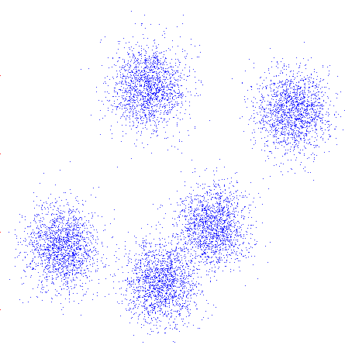
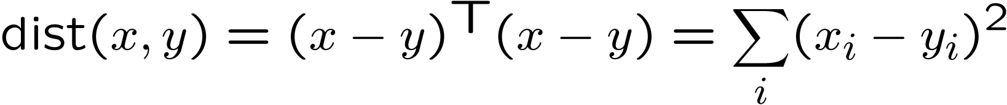
Clustering
Basic idea: group together similar instances
Example: 2D point patterns
What could “similar” mean?
One option: small (squared) Euclidean distance

Slide 7

An Example of “Clustering”
1.0, 3.0
101.0, 103.0
Given the four data points D above
Cluster them in one, two, three, or four clusters?
Let the hypothesis be H₁, H₂, H₃, H₄
Choose the H_{J} such that P(H_{J}|DX) is the highest
Where X is the background knowledge
Bayes Model
How well hypothesis explain data?
How likely is the data?
How likely is the hypothesis?

Slide 8
Different Hypotheses for Clustering (Assume Gaussian Distributions)
H₁
1.0, 3.0
101.0, 103.0
H₂
1.0, 3.0
101.0, 103.0
H₄
1.0, 3.0
101.0, 103.0

Slide 9
Clustering Algorithms
Naïve Bayes Model (AUTOCLASS)
K-Means
Agglomerative

Slide 10
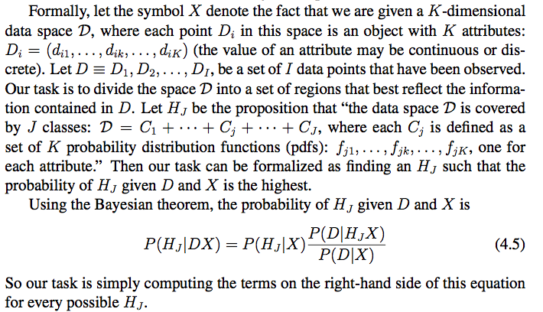
A Bayes Model
Example 1: data D = freshly caught fishes, cluster J = types of fishes
Example 2: data D = star observations, cluster J = type of stars

Slide 11
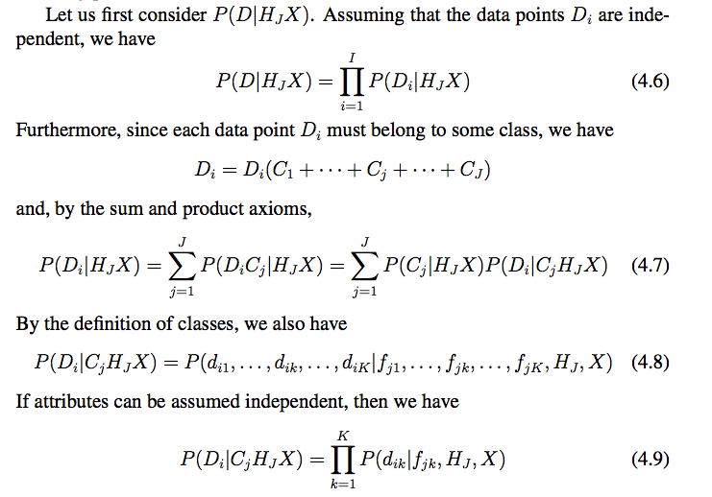
A Naïve Bayes Model
Naïve
Naïve

Slide 12
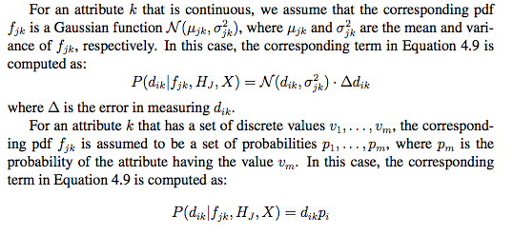
AUTOCLASS Algorithm

Slide 13
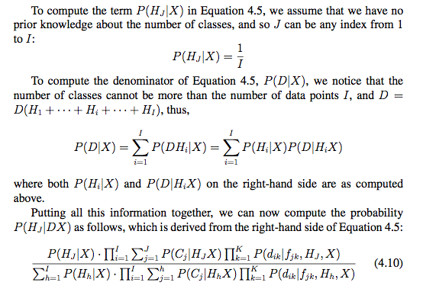
AUTOCLASS Algorithm

Slide 14
Back to Our Example
H₁
1.0, 3.0
101.0, 103.0
H₂
1.0, 3.0
101.0, 103.0
H₄
1.0, 3.0
101.0, 103.0

Slide 15


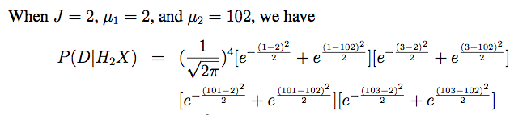


Back to the example
P(D|H₃X) = ……
Since P(X|H₂X) > P(X|H₃X) > P(X|H₄X) > P(X|H₁X), the Bayesian theorem tells that H₂ is the best hypothesis, which matches our intuition perfectly!

Slide 16
K-Means Clustering
An iterative clustering algorithm
Pick K random points as cluster centers (means)
Alternate:
Assign data instances to closest mean
Assign each mean to the average of its assigned points
Stop when no points’ assignments change

Slide 17
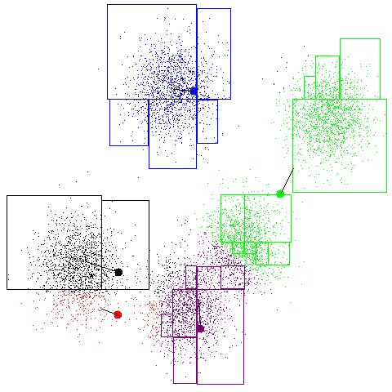
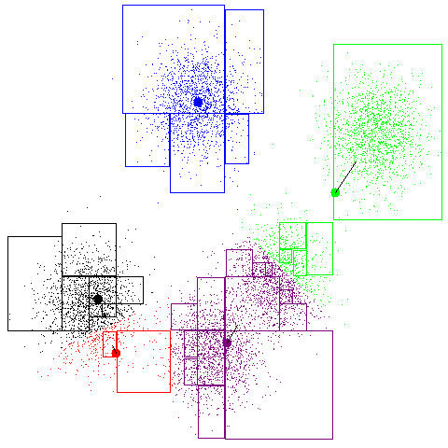
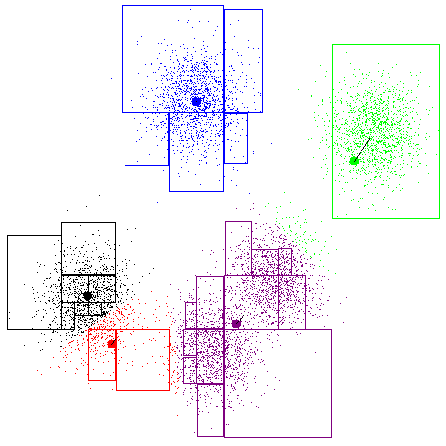
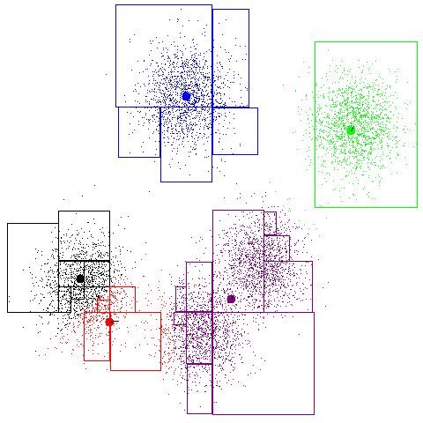
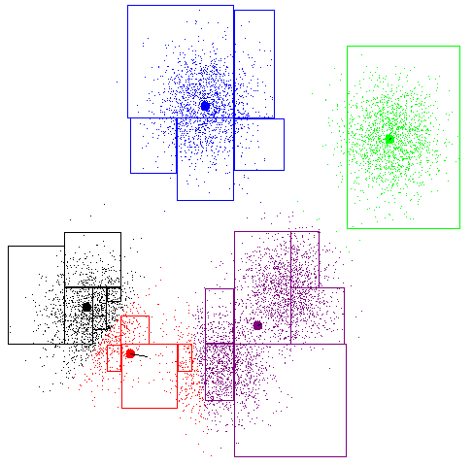
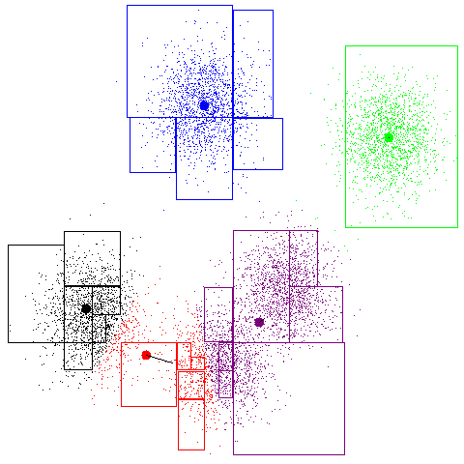
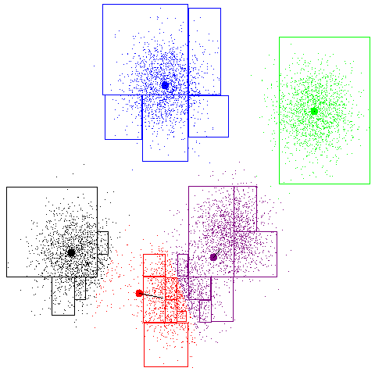
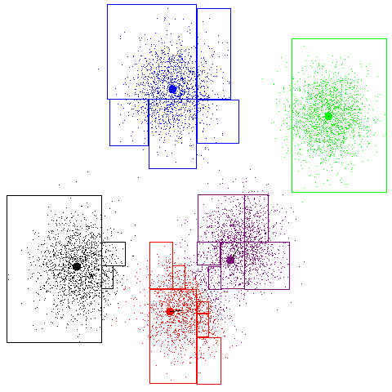
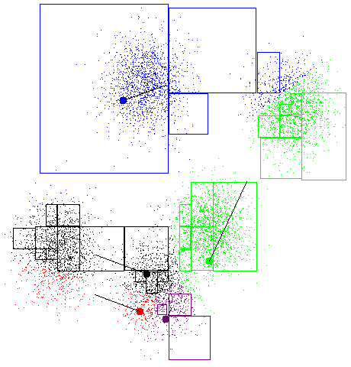
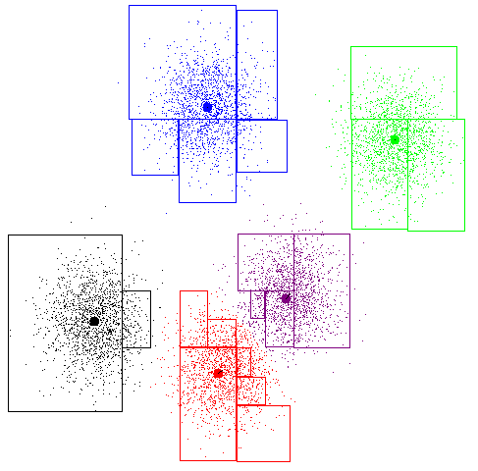
K-Means Example

Slide 18
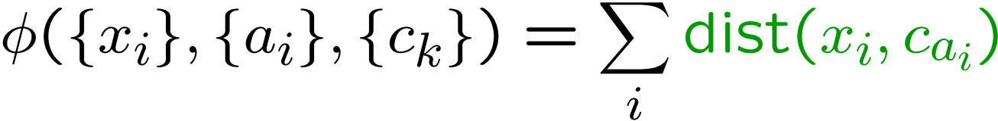
K-Means as Optimization
Consider the total distance to the means:
Each iteration reduces φ
Two stages each iteration:
Update assignments: fix means c,
change assignments a
Update means: fix assignments a,
change means c
points
means
assignments

Slide 19
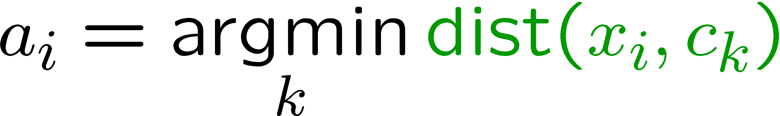

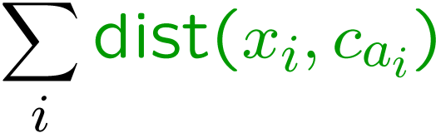
Phase I: Update Assignments
For each point, reassign to the closest mean:
Can only decrease total distance φ !

Slide 20
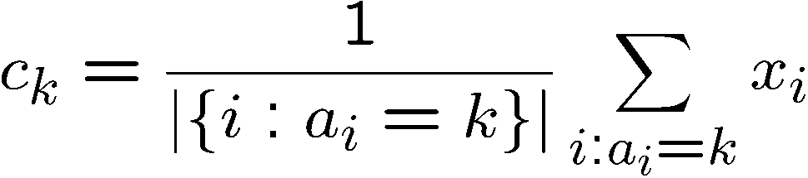
Phase II: Update Means
Move each mean to the average of its assigned points:
Also can only decrease total distance… (Why?)

Slide 21
Initialization
K-means is non-deterministic
Requires initial means
It does matter what you pick!
What can go wrong?
Various schemes for preventing this kind of thing: variance-based split / merge, initialization heuristics

Slide 22
K-Means Getting Stuck
A local optimum:
Why doesn’t this work out like the earlier example, with the purple taking over half the blue?

Slide 23
K-Means Questions
Will K-means converge?
To a global optimum?
Will it always find the true patterns in the data?
If the patterns are very very clear?
Will it find something interesting?
Do people ever use it?
How many clusters to pick?

Slide 24
Agglomerative Clustering
Agglomerative clustering:
First merge very similar instances
Incrementally build larger clusters out of smaller clusters
Algorithm:
Maintain a set of clusters
Initially, each instance in its own cluster
Repeat:
Pick the two closest clusters
Merge them into a new cluster
Stop when there’s only one cluster left
Produces not one clustering, but a family of clusters represented by a dendrogram

Slide 25
Agglomerative Clustering
How should we define “closest” for clusters with multiple elements?
Many options
Closest pair (single-link clustering)
Farthest pair (complete-link clustering)
Average of all pairs
Ward’s method (min variance, like k-means)
Different choices create different clustering behaviors

Slide 26

Clustering Application
Top-level categories: supervised classification
Story groupings:
unsupervised clustering

Slide 27
Clustering Algorithms (Review)
Naïve Bayes Model (e.g., AUTOCLASS)
Select M_{i} that has the best P(D|M_{i}),
K-Means
Loop until no improvement
Assign data to the nearest cluster
Adjust clusters to fit the assignments
Agglomerative
Always merge the pair of “closest” clusters

Slide 28
The EM Algorithm
It is not an “algorithm”, it is a Framework!
A loop of two phases
Estimation (Explanation)
Modification (Maximization)
For example, when we do clustering
Phase E: update assignment (data to cluster)
Phase M: update means (adjust clusters)

Slide 29
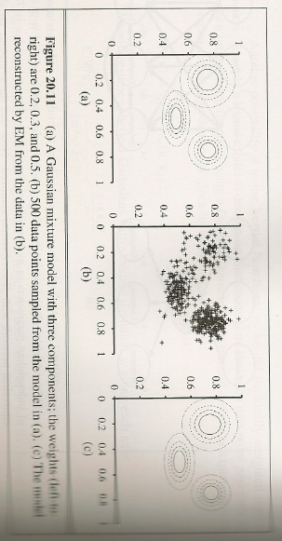
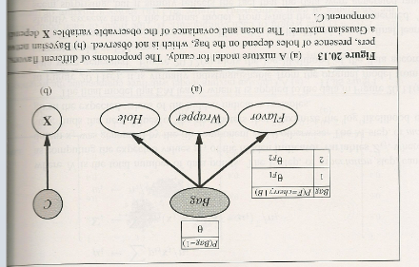
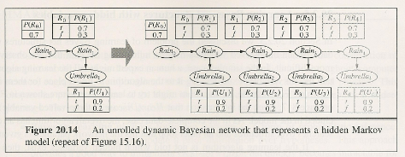
The EM Algorithm
A very general framework
Many forms & applications
Clustering with Gaussians
Bayesian net with hidden variables
Hidden Markov models (HMM)
Partially Observable Markov Decision Process (POMDP)
See e.g., ALFE 5.10
Others
We describe it by form/applications
Clustering
Learning POMDP ⬅

Slide 30

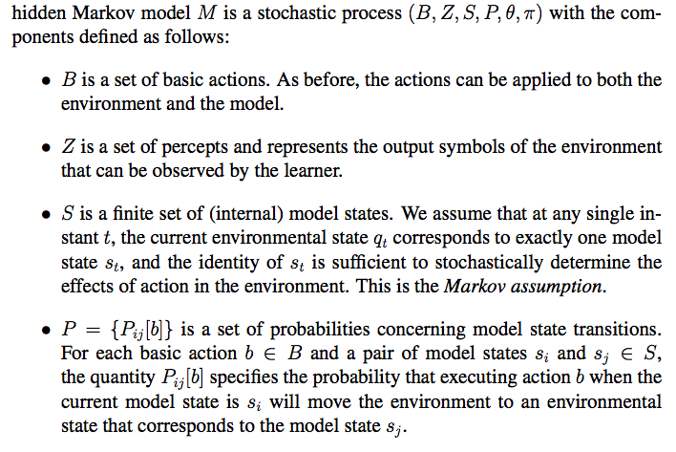
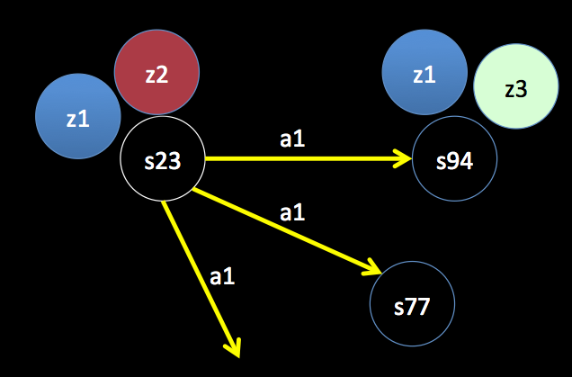
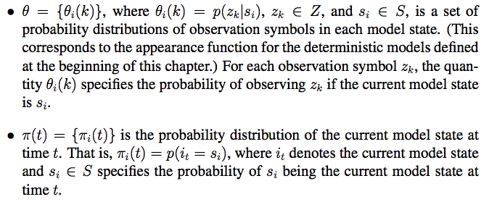
HMM/POMDP (A Review)
1. Actions
2. Percepts (observations)
3. States
4. Appearance: states → observations
5. Transitions: (states, actions) → states
6. Current State
Three key components:
- Sensor model θ=p(z|s)
- Action model P(s|s,a)
- Current state π_{t}(s) (localization)

Slide 31
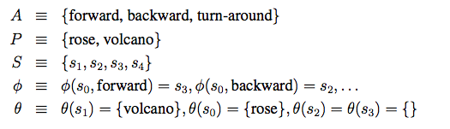
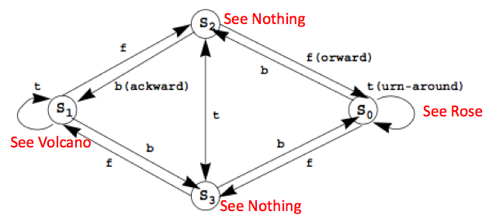
Little Prince Example
{P(s3|s0,f)=.51, P(s2|s1,b)=.32, P(s4|s3,t)=.89, …}
{P(rose|s0)=.76, P(volcano|s1)=.83, P(nothing|s3)=.42, …}

Slide 32

Learning HMM/POMDP
M = (B, Z, S, P, θ, π)
Task:
Given B, Z, S, and an experience
Improve P, θ, π.
“Improve” means better match the experience
How do we do that?
Use EM: Bayesian Again!
E-step: P(E|M): Use M to explain E
M-step: Use the explanation to improve P(M|E)

Slide 33
Little Prince Experience
E_{1:T}
{rose}, fward, {none}, …, turn, {rose}, back, {volcano}
time
S1 S2 S3 S4
S1 S2 S3 S4
S1 S2 S3 S4
S1 S2 S3 S4
Hidden!
……
Given: “experience” E_{1:T} (time 1 through T)
You can Infer:
P(X_{t}|E_{1:t}), where (which state) am I at now? (estimation)
P(X_{t+k}|E_{1:t}), where I will be at time t+k? (prediction)
P(X_{k}|E_{1:t}), where I was at time k < t ? (smooth)
P(X_{1:t}|E_{1:t}) the probability of every state sequence that I went through? (explanation)
P(x_{1:t}|E_{1:t}) the most likely sequence of states I went through? (Viterbi algorithm)

Slide 34
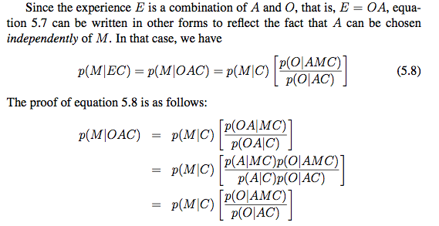
Equations for “Improving based on explanation”
Assume A and M
are independent: P(A|MC)=P(A|C)
improving
explanation

Slide 35
How to Compute P(O|AMC)?
Given
Experience E = {o₁, a₁, o₂, a₂, o₃, a₃, …, a_{T}, o_{T}}
the set of states S, sensor model θ, and action model P
Fill the state sequence “?”
o₁
o₂
o₃
o_{T}
θ
θ
θ
θ
?
a₁
?
a₂
?
a₃
a_{T}
?
P
P
P
P
t₁
t₂
t₃
t_{T}
Fill the states into the circles and then
compute the probability of the sequence of states

Slide 36
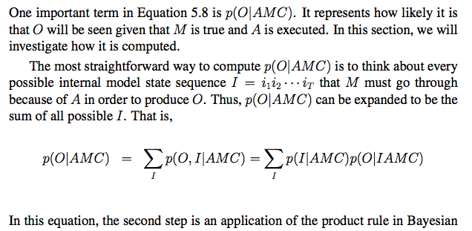
Compute Hidden State Sequence (1/2)
Experience consists of both O and A
O is observation sequence and A is action sequence in experience
M is the model, C is the background information
Little Prince Example: for three steps, how many possible I are there?

Slide 37
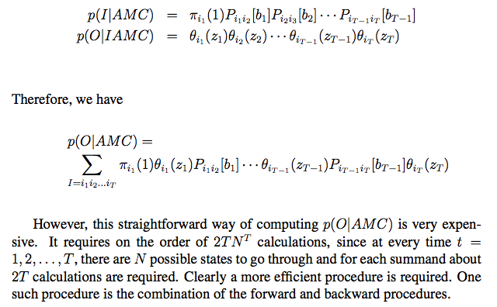
Compute Hidden State Sequence (2/2)
O = {z₁, z₂, …, z_{T}}, A = {b₁, b₂, …, b_{T}}, I = {i₁, i₁, …, i_{T}}
Among all possible sequences in I, there is one with the maximal probability.

Slide 38
Which Explanation is the Best?
Among all possible sequences of states, the best “explanation” is the sequence of states that gives the maximal value for
Experience:
Observations: o₁, o₂, …, o_{T}
Actions: b₁, b₂, …, b_{T}
Sensor model:
Action model: P_{ij}[b] = P(s_{j} | s_{i}, b)
Explanation: State sequence: i₁, i₂, i₃, …, i_{T}

Slide 39
The EM Algorithm
E-Step: Estimate P(E|M) the likelihood of the experience E given the model M
Using the model M to explain the experience E
M-Step: Maximize the parameters of the model M using the knowledge learned from the experience: P(M|E)
Using the explanation to improve the model
E.g., Baum-Welch Learning Procedure

Slide 40
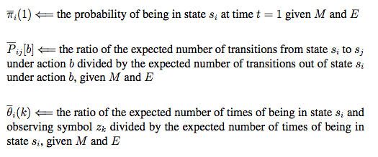
Baum-Welch Learning Procedure
Using the explanation of the experience to change the model:

Slide 41
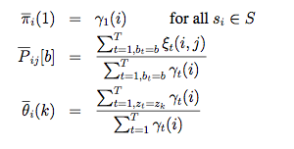

Update P, θ, π using α, β, γ, ξ
(Smooth) Use the whole experience to determine the beginning
From all s_{i}, how many go to s_{j}
From all s_{i}, how many look like z_{k}
(Smooth) Use the whole model
to determine the next state
E_{1:T}
{rose}, fward, {none}, …, turn, {rose}, back, {volcano}
time
S1 S2 S3 S4
S1 S2 S3 S4
S1 S2 S3 S4
S1 S2 S3 S4
Hidden!
……

Slide 42

Little Prince Example
Computing α, β, γ, ξ using the experience
E = {rose}, forward, {nothing}, forward, {volcano}
States: s₀, s₁, s₂, s₃
Init state distribution: 0.25, 0.25, 0.25, 0.25
Transitions: P( S_{j} | S_{i}, forward):
Observations Z=<rose, volcano, nothing>
Sensor model:
S₀ S₁ S₂ S₃
S₀ S₁ S₂ S₃
S₀ S₁ S₂ S₃

Slide 43
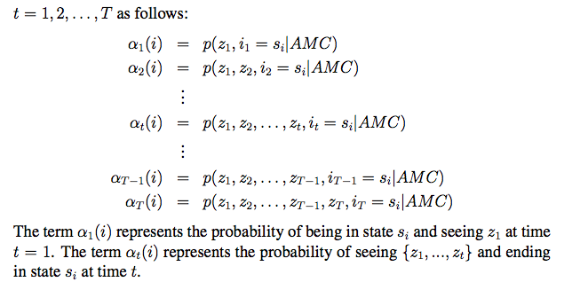

Forward Procedure
Compute step by step:
α_{t}(i): the probability at the state s_{i} at time t given E

Slide 44


Compute α values
α₁(s₃)=0.25*0.8=0.2
α₁(s₂)=0.25*0.5=0.125
α₁(s₁)=0.25*0.2=0.05
α₁(s₀)=0.25*0.4=0.1
α₂(s₃)=(.2*.1+.125*.1+.05*.1+.1*.4)*0.1
α₂(s₂)=(.2*.5+.125*.1+.05*.3+.1*.2)*0.2
α₂(s₁)=(.2*.3+.125*.3+.05*.3+.1*.1)*0.2
α₂(s₀)=(.2*.1+.125*.5+.05*.3+.1*.3)*0.1
S₀ S₁ S₂ S₃

Slide 45
Compute α values
α₁(s₃)=0.2
α₁(s₃)=0.125
α₁(s₁)=0.05
α₁(s₀)=0.1
α₂(s₃)=0.00775
α₂(s₂)=0.0295
α₂(s₁)=0.092
α₂(s₀)=0.0125
α₃(s₃)=(.00775*.1+.0295*.1+.092*.1+.0125*.4)*0.1
α₃(s₂)=(.00775*.5+.0295*.1+.092*.3+.0125*.2)*0.3
α₃(s₁)=(.00775*.3+.0295*.3+.092*.3+.0125*.1)*0.6
α₃(s₀)=(.00775*.1+.0295*.5+. .092*.3+.0125*.3)*0.5

Slide 46

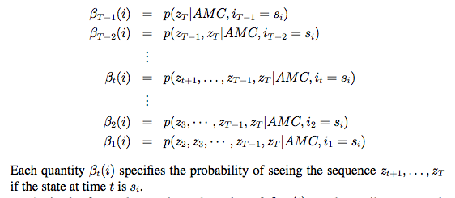
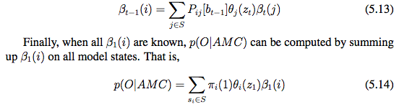
Compute β_{t}(i) by Backward Procedure
β_{t}(i): given E, the probability of being at the state s_{i} at time t

Slide 47

Compute β values
β₂(s₃)=(.1*.1+.5*.3+.3*.6+.1*.5)*1.0
β₂(s₂)=(.1*.1+.1*.3+.3*.6+.5*.5)*1.0
β₂(s₁)=(.1*.1+.3*.3+.3*.6+.3*.5)*1.0
β₂(s₀)=(.4*.1+.2*.3+.1*.6+.3*.5)*1.0
β₃(s₃)=1.0
β₃(s₂)=1.0
β₃(s₁)=1.0
β₃(s₀)=1.0
S₀ S₁ S₂ S₃

Slide 48
Compute β values
β₁(s₃) = fill in here in the class
β₁(s₂)=
β₁(s₁)=
β₁(s₀)=
β₂(s₃)=0.39
β₂(s₂)=0.47
β₂(s₁)=0.43
β₂(s₀)=0.31
β₃(s₃)=1.0
β₃(s₂)=1.0
β₃(s₁)=1.0
β₃(s₀)=1.0

Slide 49
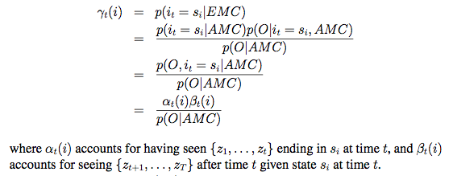
ϒ_{t}(i) Value: Putting α and β together
ϒ_{t}(i) is the “smoothing” probability of being at state s_{i} at time t given the entire experience E_{1:T}
S1 S2 S3 S4
S1 S2 S3 S4
S1 S2 S3 S4
S1 S2 S3 S4
s_{i}
t

Slide 50
Compute γ = α*β
γ₁(s₃)
γ₁(s₂)
γ₁(s₁)
γ₁(s₀)
γ₂(s₃)
γ₂(s₂)
γ₂(s₁)
γ₂(s₀)
γ₃(s₃)
γ₃(s₂)
γ₃(s₁)
γ₃(s₀)

Slide 51
Putting α and β together
α₁(s₃)=0.2
α₁(s₃)=0.125
α₁(s₁)=0.05
α₁(s₀)=0.1
β₁(s₃)
β₁(s₂)
β₁(s₁)
β₁(s₀)
α₂(s₃)=0.00775
α₂(s₂)=0.0295
α₂(s₁)=0.092
α₂(s₀)=0.0125
β₂(s₃)=0.39
β₂(s₂)=0.47
β₂(s₁)=0.43
β₂(s₀)=0.31
α₃(s₃)=.0017925
α₃(s₂)=.0110775
α₃(s₁)=.024015
α₃(s₀)=.0234375
β₃(s₃)=1.0
β₃(s₂)=1.0
β₃(s₁)=1.0
β₃(s₀)=1.0

Slide 52
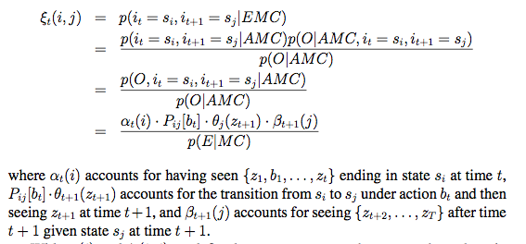
ξ_{t}(i,j) Value
ξ_{t}(i,j) is the probability of making the transition from s_{i} to s_{i} at time t in the experience E_{1:T}
S1 S2 S3 S4
S1 S2 S3 S4
S1 S2 S3 S4
S1 S2 S3 S4
s_{i}
b_{t}
s_{j}
t t+1

Slide 53
Example ξ value
ξ₁(s_{i},s_{j}) =
α₁(s₃)=0.2
P(s₂|s₃)=0.3
α₁(s₃)=0.2
α₁(s₂)=0.125
α₁(s₁)=0.05
α₁(s₀)=0.1
β₂(s₃)=0.39
β₂(s₂)=0.49
β₂(s₁)=0.43
β₂(s₀)=0.31
α₃(s₃)=.0017925
α₃(s₂)=.0110775
α₃(s₁)=.024015
α₃(s₀)=.0234375
θ_{s2}(nth)=0.2
β₂(s₂)=0.47

Slide 54
Improve the model by explanation Update P, θ, π using α, β, γ, ξ
Use the whole experience to determine the beginning
From all s_{i} in E, how many go to s_{j}
From all s_{i} in E, how many appear as z_{k}
Use the whole experience to determine
the distribution for the next state

Slide 55
The General EM Algorithm
E-Step: Estimate P(E|M) the likelihood of the experience E given the model M
E.g., computing α, β, γ, ξ using the experience
K-means: assigning data to the (closest) clusters
M-Step: Maximize the parameters of the model M using the knowledge (e.g., explanations) learned from the experience
E.g., update P, θ, π using α, β, γ, ξ
K-means: move the clusters based on the assignments

Slide 56
Comments on EM
The most general and powerful learning method
Many existing algorithms are special cases of EM
Tremendous application potentials
Robot navigation, localization, mapping, SLAM, manipulation, planning, etc.
Natural language processes (IBM’s Watson)
Data Mining
Gaming that can improve themselves
Discovering patterns from genetic and health data
The Future?
What if we don’t know the states? Can we learn?
That will be our “Surprise-Based Learning”!

